Slide 1
THE “FLOUR MAN”
Following the Lead of Fairy-Tales (Sharing the Fairy-Tale Treasure around Europe)

Slide 2
Once upon a time there was a king who had a daughter. When it was time for the girl to get married she didn’t like anybody. She asked her father to bring her a sack full of almonds, a sack of flour and a sack of sugar. She stayed into her bedroom for 40 days and she made a man with all these ingredients. She called this man “flour man”. She decided that this man would be her husband.

Slide 3
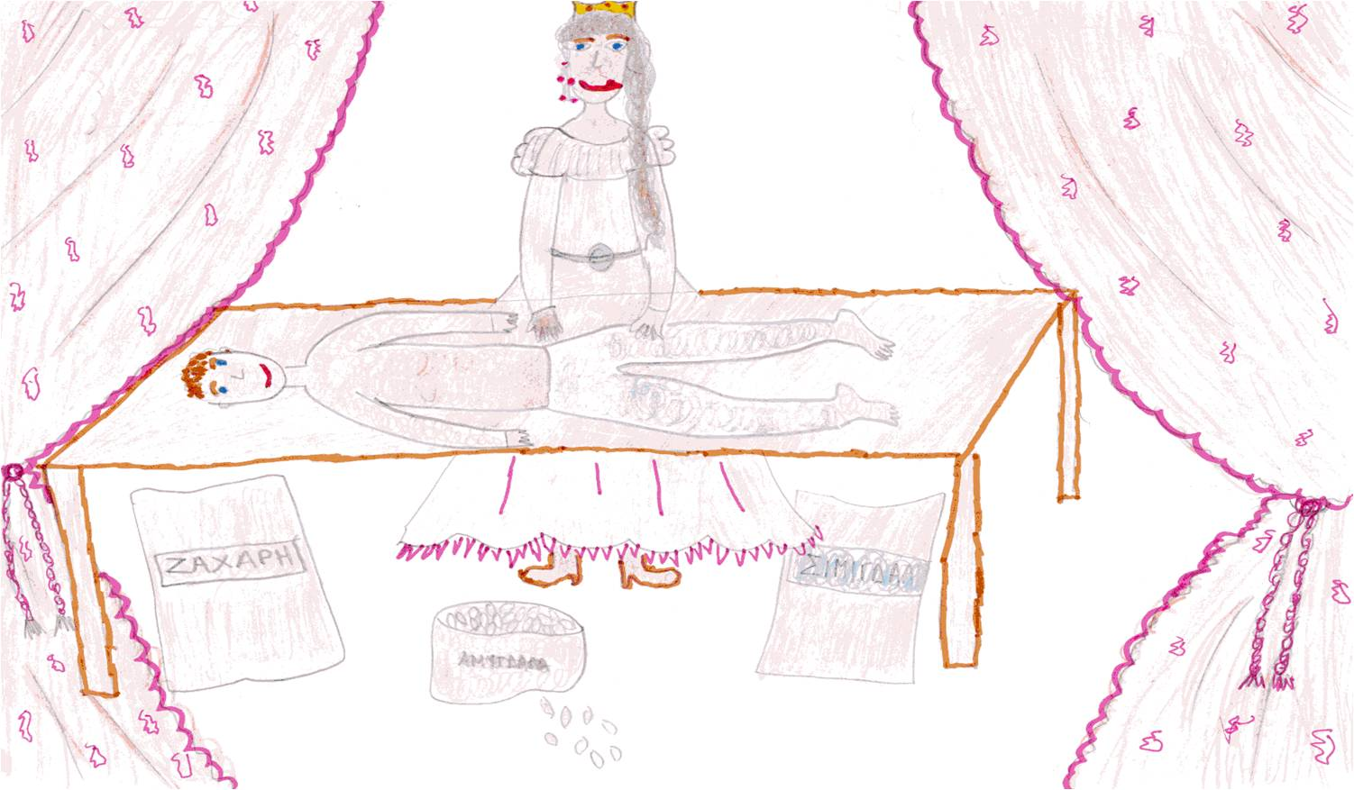
The princess is making the “Flour Man” Anna Demeli – D Class

Slide 4
In the neighboring country the daughter of the king learnt the news and she was really jealous. The king, in order to make her happy, made a ship full of gold and jewelry and sent it to the port of the other country. They wanted to cheat the sailors and steal the “flour man”.

Slide 5
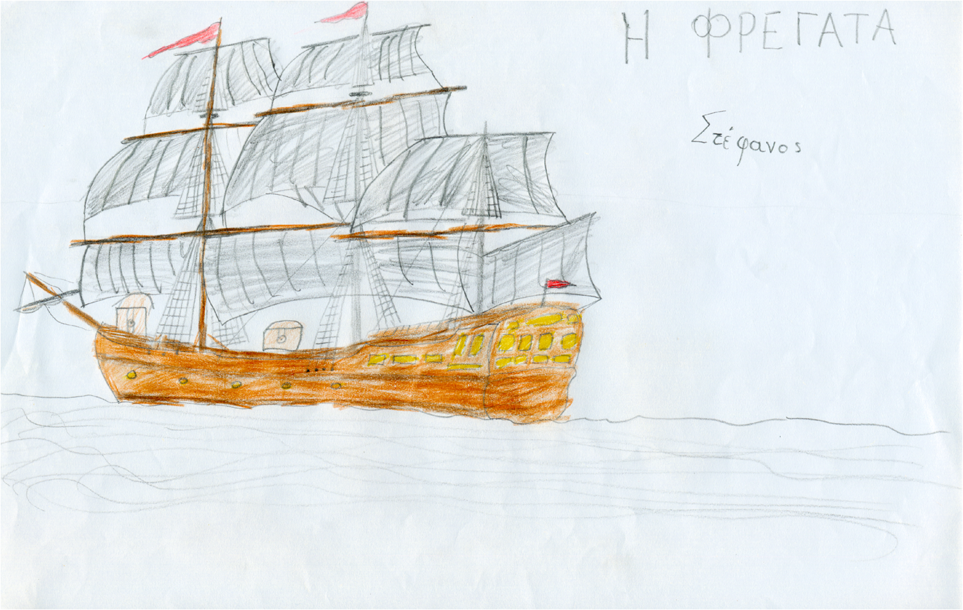
The ship into the port Stefanos Akrivogiannis – E Class

Slide 6
When the princess saw the ship she asked the “flour man” to buy something for her. Although he didn’t want, at the end she persuaded him. So, he went to the ship, but before he had any time to buy anything, the ship sailed for its country.
The king welcomed him and he gave him to drink the “water of oblivion”. When somebody drinks this he forgets everything. So the “flour man” soon forgot his wife and he married the second princess.
When the first princess realized the absence of the husband she was very worried. She almost died.

Slide 7
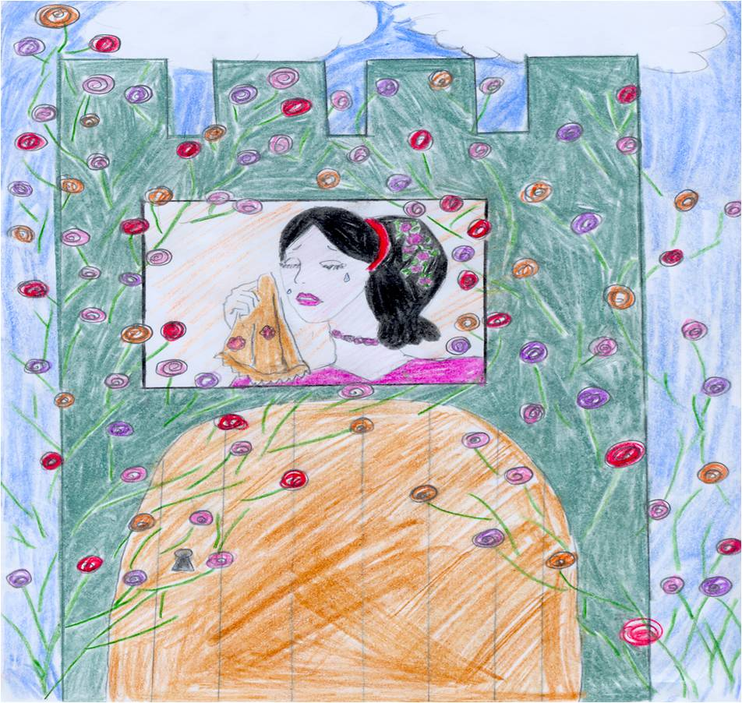
The princess is sad because she has lost the “Flour Man” Vaso Kandila – F class

Slide 8
When she realized that she couldn’t do anything she tried to find him herself. She started walking and walking. She arrived at the house of Sun. First she spoke to the Sun’s mother and then she asked the Sun about her lost husband. But there was no answer… The Sun was too high, so he hadn’t seen anything.

Slide 9
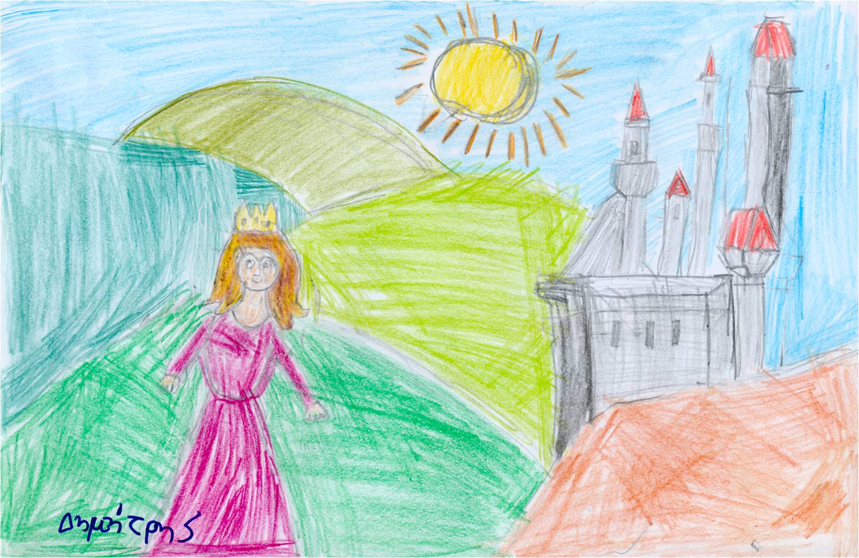
The princess at the House of the Sun Dimitris Bobos – A class

Slide 10
Then she walked and walked again and she arrived at the house of Moon. She spoke to the Moon’s mother, who was really sorry about her, so she let her speak to the Moon and asked him about her lost husband. But he also answered that he hadn’t seen anything.

Slide 11
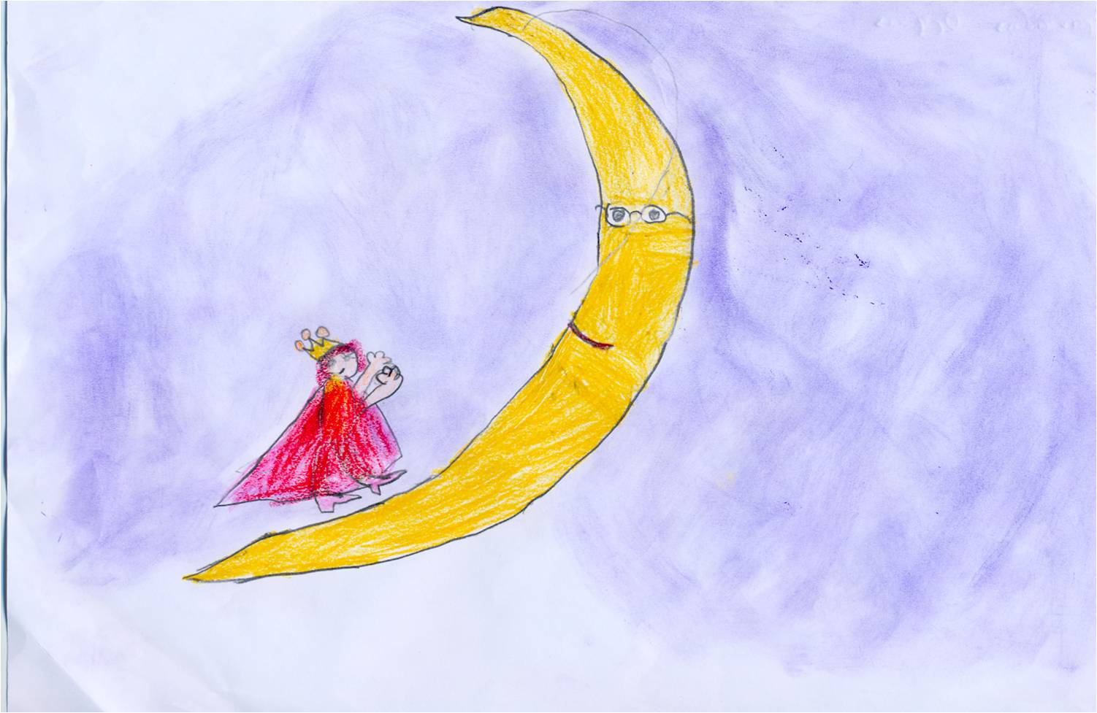
The princess at the House of the Moon Orpheus Ifantidis – B Class

Slide 12
The days passed and she kept walking. She arrived at the house of Stars. There the smallest Star said that he had seen the “flour man” and he promised to take her to the place he had been hidden.

Slide 13
The princess at the House of Stars Maria Kontoriga – C Class

Slide 14
So the princess walked and walked again and she finally arrived at the neighboring country. She pretended to be a poor and orphan lady and asked if she could stay at the palace. She was given a small room. She saw the “flour man” and started crying. She had a walnut with her, that the Sun’s mother had given it to her. She broke it and there was a golden needle inside.

Slide 15
The princess of the country was jealous when she saw it. She wanted to buy the golden needle. But the princess didn’t want any money. The only thing she asked for was to take the “flour man” in her bedroom just for one night. So it happened this way.
But the princess of that country had given the “flour man” a sleeping drink and he was sleeping the whole night. So he didn’t listen to the stories of his ex-wife who was crying.

Slide 16
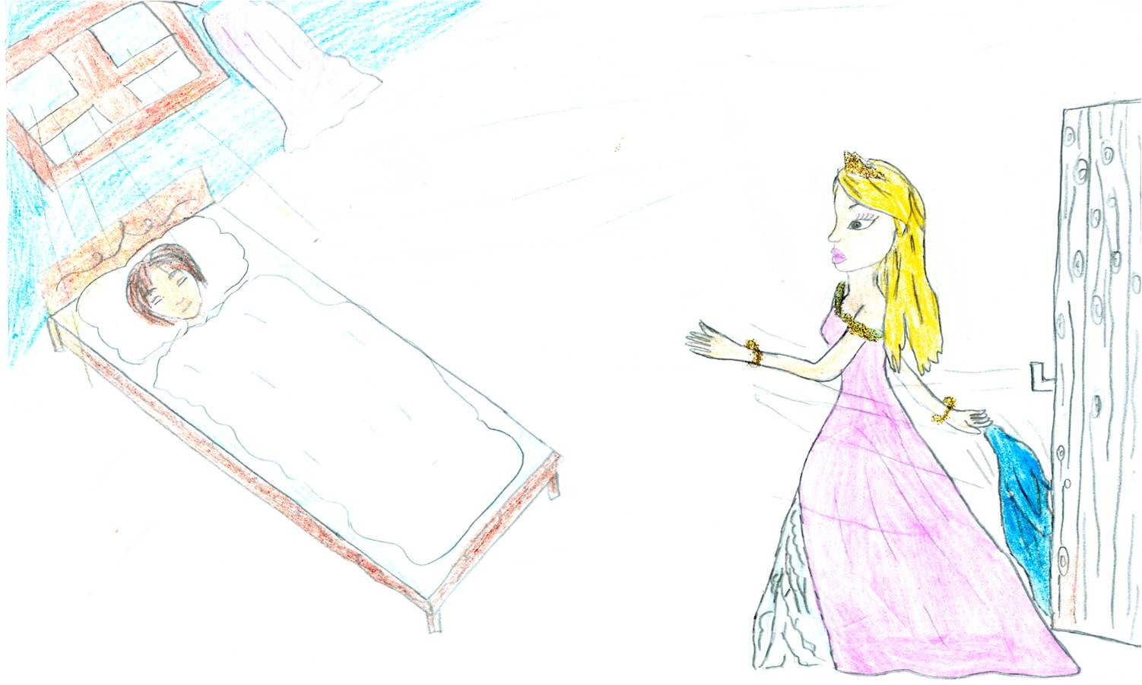
The princess and the “Flour Man” who is asleep Elisabeth Theohari – E Class

Slide 17
The next day the poor princess broke an almond, which was given to her by the mother of Moon as a gift. There was a golden thread inside the almond. When the princess of the country saw it she wanted to buy it. But again the poor princess asked for the same thing, to spend a night with the “floor man”. But the princess gave him the sleeping drink again and he slept the whole night.

Slide 18
The third day the poor princess broke a hazelnut, which was given to her by the Stars. There were a golden hen and three golden chickens inside the hazelnut. The princess was jealous again and she wanted to buy them. So she was convinced to leave the “flour man” sleep in the poor princess’s bedroom for one more night. But the “flour man” who had understood something poured the sleeping drink and he pretended to be sleeping. When he talked to the first princess he realized what the truth was and he decided to leave with her secretly at night.
So they left together and they arrived at their palace and they live happily ever after.

Slide 19
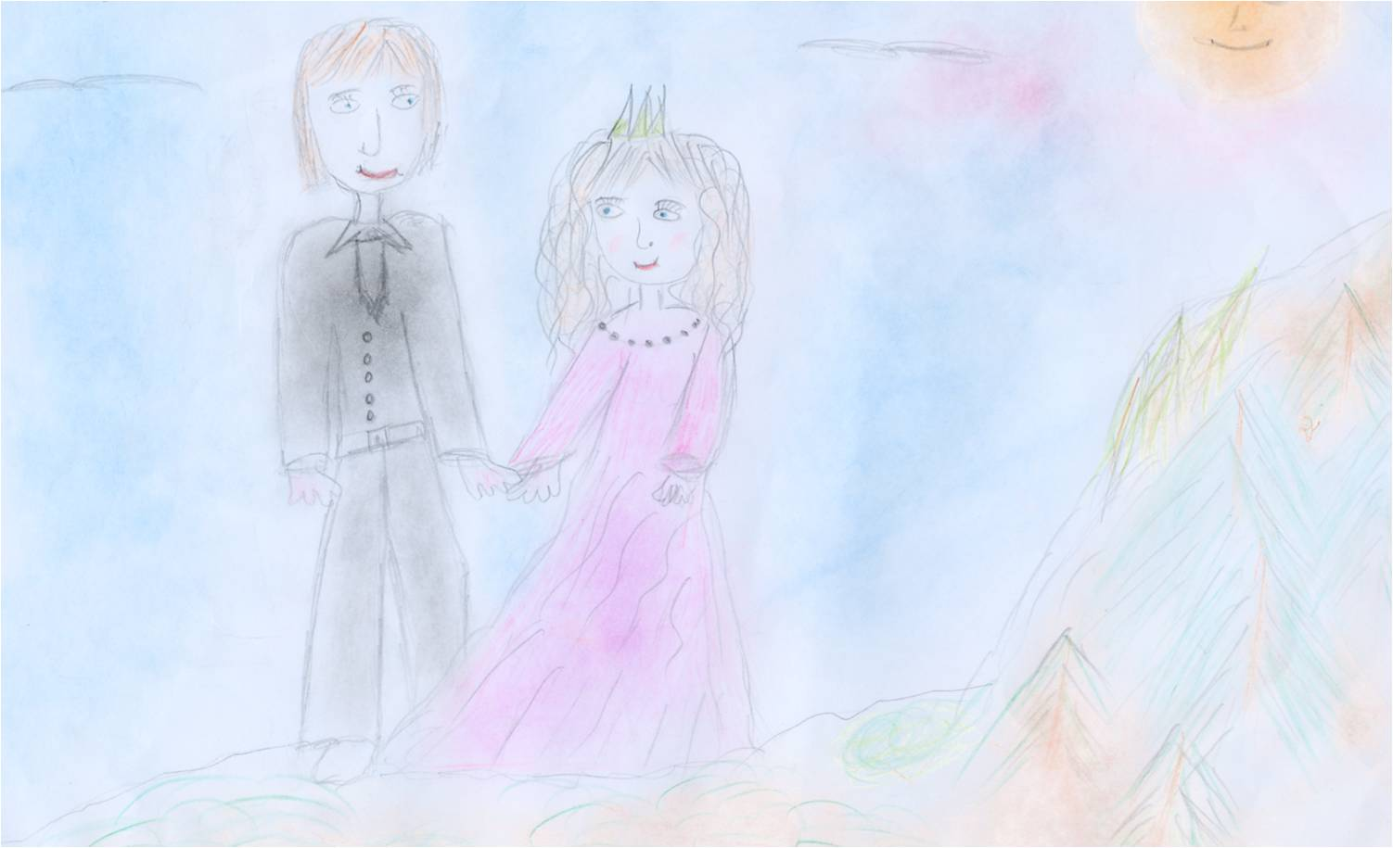
The “Flour Man” and the princess are going away secretly at night Eleanna Rebelakou – F class

